Slide 1
Visualizing and describing spatial data
GEOG4300 /6300: Intro to data science
Prof. Jerry Shannon

Slide 2
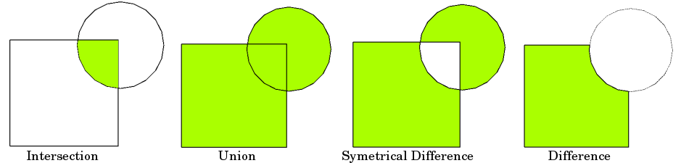
What is a spatial operation?
Altering the structure of spatial data based on its attributes, location, and/or topology.

Slide 3
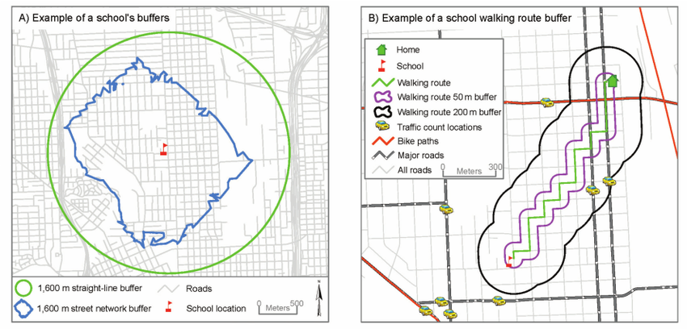
Buffer
Identifies the area within a set distance of a vector feature
Link

Slide 4
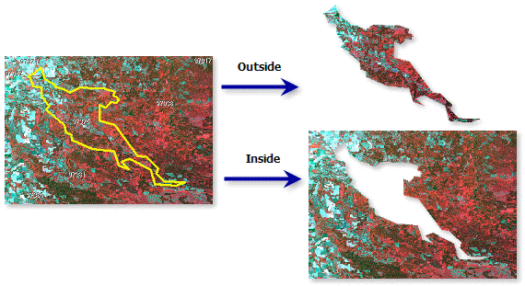
Clip
Deletes any features or parts of features not within another layer.
Link

Slide 5
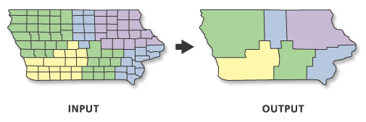
Dissolve
Combines observations, often based on a categorical variable (e.g., census blocks by school attendance zone)
Link

Slide 6
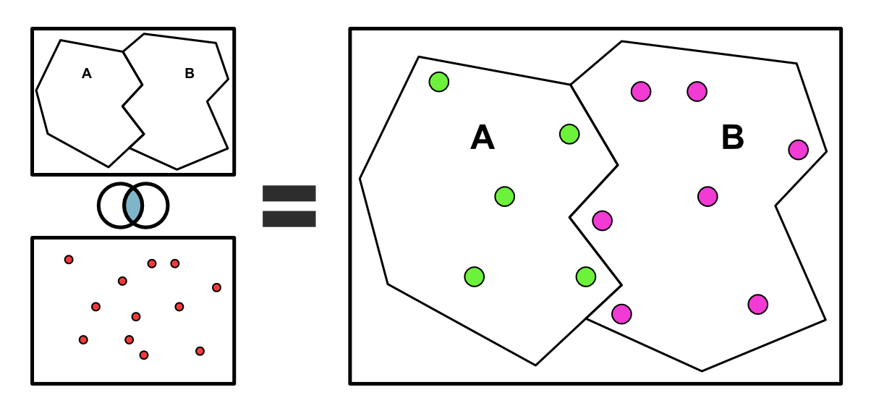
Spatial join
Combine the attributes of two features based on a spatial relationship (e.g., add county name to survey responses)
Link

Slide 7
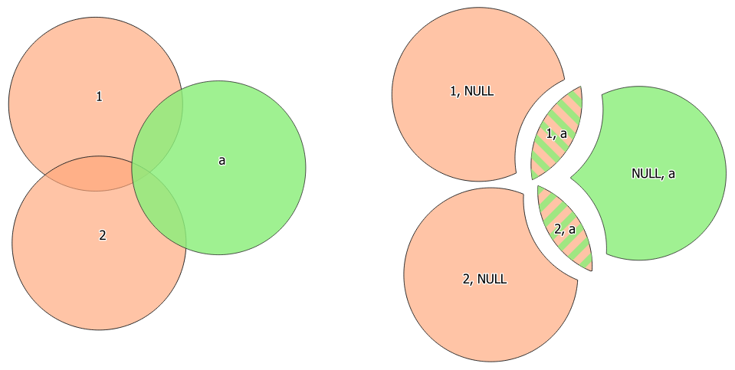
Union
Combine two polygon layers, often keeping all borders in both layers. (e.g., census tracts and police districts)
Link

Slide 8
Which spatial function should be used?
Identifying how many fast food restaurants are within 3 miles of a school.
Cutting out those parts of a census tract that are NOT zoned for residential housing.
Combine local political districts with school attendance zones, creating new polygons for each unique combination of the two.
Creating a new country polygon from a dataset showing its state boundaries.
Buffer
Clip
Spatial Join
Dissolve
Union
Notes:
They share these in small groups and then look at the examples on the next page.

Slide 9
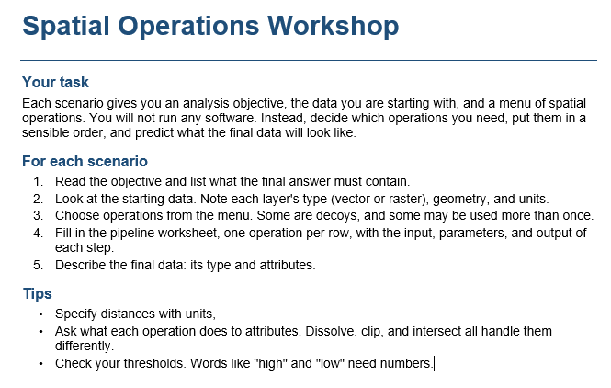
Let’s try them out!

